Slide 1

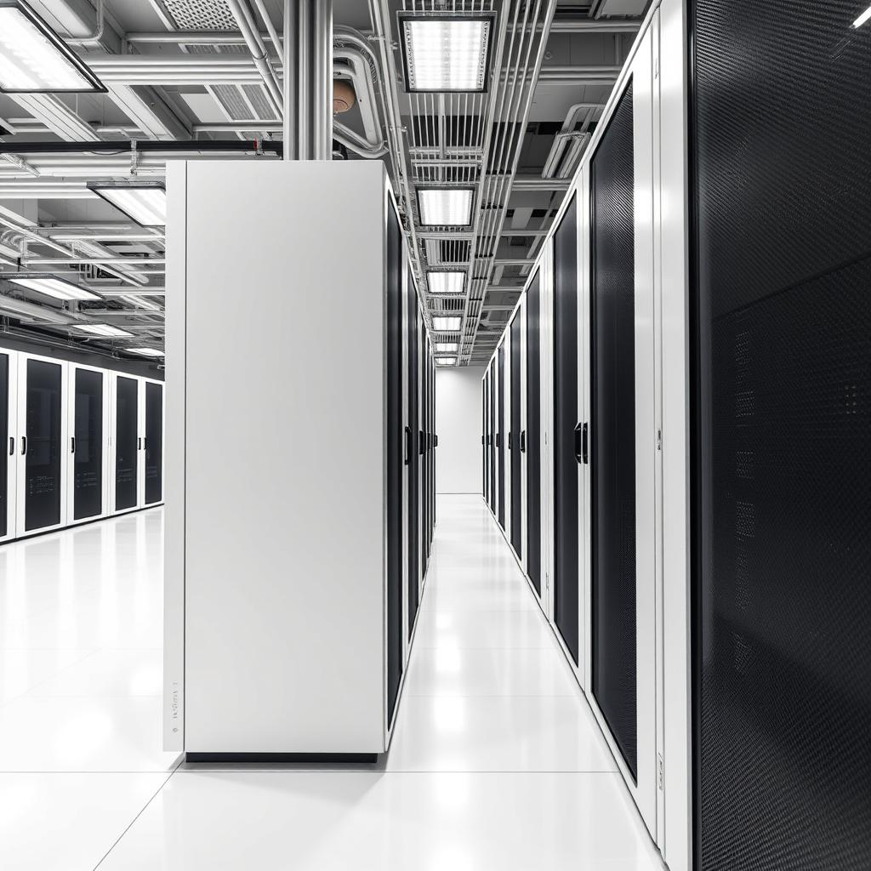
Cloud Computing
Cloud computing provides on-demand access to computing resources like servers, storage, and software over the internet.

Slide 2
What is Cloud Computing?
Traditional Computing
Involves owning and managing physical infrastructure on-premises. Organizations need to invest in hardware, software, and IT personnel.
Cloud Computing
Leverages shared resources and services provided by third-party providers over the internet, eliminating the need for physical infrastructure.

Slide 3
Types of Cloud Deployments
Public Cloud
Shared infrastructure and services provided by a third-party vendor, accessible over the internet.
Private Cloud
Dedicated infrastructure and services for a single organization, often hosted on-premises or in a dedicated data center.
Hybrid Cloud
Combines public and private cloud resources, allowing organizations to leverage the best of both worlds.
Community Cloud
Shared infrastructure and services for a group of organizations with common interests or goals, such as industry verticals.

Slide 4
Cloud Service Models
IaaS
Infrastructure as a Service (IaaS) provides access to fundamental computing resources like servers, storage, and networking. It allows organizations to manage their infrastructure virtually, reducing the need for physical hardware.
PaaS
Platform as a Service (PaaS) offers a platform for developing, deploying, and managing applications. It includes tools, libraries, and runtime environments, simplifying the development process.
SaaS
Software as a Service (SaaS) provides ready-to-use applications delivered over the internet. Users can access and utilize these applications without installing or maintaining any software locally.

